Slide 1




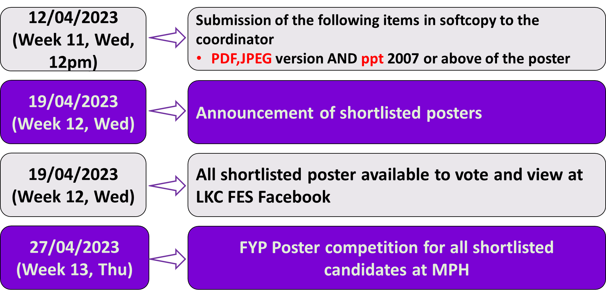


PRIZES:
Winning posters from each track and the “Most-Liked Poster” will receive certificates of achievement. Certificates will be given to all shortlisted posters.
Vote for your favorite poster between 19th April 2023 and 26 April 2023 (5pm). Log on to LKC FES Facebook for the voting link during Week-12 to Week-13.
REGISTRATION:
No registration fees. Participant(s) are only required to submit the necessary documents mentioned in the “Important Dates” section below, to their respective FYP coordinator for the preliminary assessment by Week-11, Wednesday, 12pm.
IMPORTANT DATES:
For any queries, please contact individual department’s FYP coordinator:
DMAS: Dr Liew How Hui (liewhh@utar.edu.my)
DCI: Dr. Lee Yee Ling (yllee@utar.edu.my)
DCL: Dr. Yap Yeow Hong (yapyh@utar.edu.my)
D3E: Ts Dr Chew Kuew Wai (chewkw@utar.edu.my)
DMBE: Dr. Hau Lee Cheun (haulc@utar.edu.my)
DMME: Dr. Ting Chen Hunt (tingch@utar.edu.my)
DS: Dr. Lew Yoke Lian (lewyl@utar.edu.my)
DIECS: Dr Lee Ming Jie (leemj@utar.edu.my)
DASD: Encik Abd Muluk (abdmuluk@utar.edu.my)
FYP Committee Chair
Ir. Dr. Lim Boon Han (limbhan@utar.edu.my)
The Most-liked Poster Award (The poster with the most likes)
FYP Poster Competition
&
Industry Interaction Day
(Jan 2023 Trimester)
Date: 27 April 2023
Time: 8am – 4pm
Venue: MPH, KB block
Organised by:
Lee Kong Chian Faculty of Engineering & Science
Universiti Tunku Abdul Rahman
(Sungai Long Campus)
It is COMPULSORY for ALL FYP part-2 students to:
participate in the FYP poster competition
attend for the FYP poster competition (students have to sign-in)
prepare the ‘summary of 2 FYP posters’ and get the ‘summary of 2 FYP posters’ acknowledged by the FYP Committee during the event.
All shortlisted posters will be available at the LKC FES Facebook by Week-12.
*Note:
Use high resolution setting and PowerPoint version 2007 or above, to save the poster in .pdf and .ppt/.pptx, and JPEG respectively.
For JPEG file, Single dimension < 30k
Total pixels < 10 mil, File size < 3Mb
Winners: Prize + certificate
Shortlisted Posters: Certificate
of participation
Most-liked Poster: Prize +Certificate

Slide 2
Table 1: Guidelines for shortlisted FYP poster competition
(For T1 guidelines, please refer to Encik Abd Muluk )
FYP POSTER TRACKS:
Participant(s) are required to follow their own department track number among the NINE tracks given below.
TRACKS FOR POSTER PRESENTATION:
T1. Department of Architecture & Sustainable Design (DASD)
T2. Department of Mathematical and Actuarial Sciences (DMAS)
T3. Department of Mechatronics and BioMedical Engineering (DMBE)
T4. Department of Electrical and Electronic Engineering (D3E)
T5. Department of Internet Engineering and Computer Science (DIECS)
T6. Department of Surveying (DS)
T7. Department of Civil Engineering (DCI)
T8. Department of Mechanical and Material Engineering (DMME)
T9. Department of Chemical Engineering (DCL)
OBJECTIVES:
The objectives of FYP Poster Competition are:
To provide an opportunity for the final year students to demonstrate their independence, originality and ethics.
To cultivate research interests among LKC FES students.
To prepare the students to a real competitive environment.
To train the students to showcase their talent, skills and ideas through their projects.
To motivate the students to participate in external competitions, win awards and raise the good name of UTAR.
RULES & REGULATIONS:
All LKCFES FYP part-2 students of JAN 2023 trimester are required to take part in the competition.
The participation is by individual except DMAS.
All shortlisted posters will be announced during Week-12.
All shortlisted posters will be printed by the Faculty.
All shortlisted participants are REQUIRED to present their posters at the allocated booth during the competition.
The posters will be evaluated on the event day by judges appointed by the faculty. The decision of the judges is final.
During the poster presentation, students may use the video/ photo/ prototypes of their projects (if necessary). However, NO extra space, NO power socket and NO extra time will be provided.
Presentation to the judges shall not be more than 10 minutes per poster for all tracks except track T1. Track T1 presentation shall not be more than 15 minutes. The time allocation includes the Q&A session and the prototype demonstration (if applicable).
Log on to https://sites.google.com/utar.edu.my/lkcfes-fyp/poster-competition/lkc_fes-competition for more details of the poster competition, rules and regulations
Table 1 shows the guidelines for the preparation of the FYP poster and the presentation for all tracks except track- T1. For track T1 guidelines, please refer to Encik Abdul Muluk (DASD).
 | Visually appealing and strongly effective presentation. Easy to read. Utilized creativity in use of fonts, headings, colors, and white space.
 | Topic of research is clearly evident. Layout of poster is logical and provides sequential information from introduction to conclusion and references.
 | Well summarized. Clearly shows development of study or research. Material appears to accurately support purpose of study, hypothesis, or research question. Strong conclusion and implications presented.
 | Presenter was confident and professional. Established eye contact. Clearly conveyed research problem, methods, conclusions, and implications. Answered questions well. Discussed research in layman’s terms or appropriate to judge.
Poster Appearance
T2-T9:
30%
Poster Organization
T2-T9 :10%
Poster
Content
T2-T9 :35%
Oral
Presentation
T2-T9 :25%

